Slide 1
DRONES DYNAMICS IN DISASTER MANAGEMENT
MAJ GEN ANURAG GUPTA
JT SECY OPS & COMNS

Slide 2
PREVIEW
Introduction
Characteristics of Drones
Platforms & Payloads
Employment during Disasters
Case against Drones

Slide 3
INTRODUCTION
Promising and powerful new technology
Complements traditional manned relief operations
Provides better situational awareness
Assist with risk assessment, mapping, and planning
Suited to perform the “3-D (dull, dirty and dangerous) missions
Need for integration of drones into the national airspace system
Paradigm shift from a promising technology to a game changing reality

Slide 4
Characteristics of DroneS
Reduce disaster worker’s exposure to danger
Enhance effectiveness of responders
Unique viewing angles at low altitudes
Highly deployable
Cost-efficient

Slide 5
DRONE PLATFORMS

Slide 6
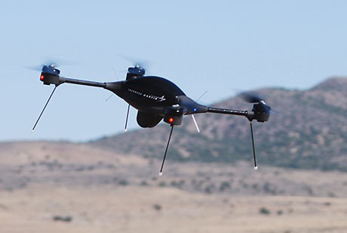
GROUP I
WEIGHT - UNDER 10 KGS
CEILING - 1000’
PROPULSION - BATTERY
ENDURANCE - UPTO 2 HOURS
PAYLOAD - VERY LIGHT

Slide 7
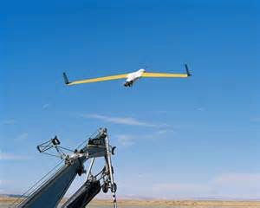
GROUP II
WEIGHT - 10 to 25 KGS
CEILING - 3500’
PROPULSION - DIESEL/GAS
ENDURANCE - 24 HOURS
PAYLOAD - LIMITED

Slide 8
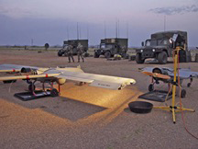
GROUP III
WEIGHT – BELOW 500 KGS
CEILING - 18000’
PROPULSION - DIESEL/GAS
ENDURANCE - 6 to 10 HOURS
PAYLOAD - IN EXCESS OF 50 KGS

Slide 9
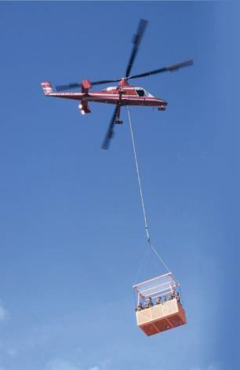
GROUP IV
adapted from manned aircraft and ARE “unmanned” with an autonomy kit ON board.
WEIGHT – ABOVE 500 KGS
CEILING - 18000’
ENDURANCE - 6 to 10 HOURS

Slide 10
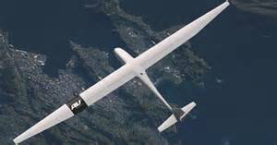
GROUP V
SAME SIZE AND CAPABILITY AS A MANNED AIRCRAFT BUT WITHOUT A PILOT
SOLAR POWERED
ENDURANCE - UPTO A WEEK

Slide 11
Payloads
Electro-Optical/Infrared / Thermal Imaging Sensors
Mapping sensors
Communications Relay
Sniffers/ Sensors
Cargo holds/ Personnel Capsule
Fire fighting

Slide 12
Employment DURING DISASTERS
Mapping
Search and Rescue Operations
Structural Integrity Assessment
Temporary Infrastructure / Supply Delivery
High-Rise Building Fire Response
CBRN Events
Logistics Support DRONES FOR DISATER MANAGEMENT01.mp4

Slide 13
Case Against Drones
Expensive, requires knowledgeable operators and maintenance workers
Short track record of successful use in disaster relief
A logistical challenge
Issue of invasion of privacy
Security issues
Aviation safety

Slide 14
IN CONCLUSION Drone Camera in Relief Operation.mp4

Slide 15
Thank You

